Slide 1
Utility Billing System
Presented by:
Shikhar Srivastava
Date:- 9/1/2026

Slide 2
Table of Content
Business Context and Problem statement
Project Objective
Solution and Key Features
Technology Stack
System Architecture
User Roles
System Flowchart
Security Features
Quality Assurance and Testing
Project Screenshots

Slide 3
Business Context & Problem Statement
Lack of Oversight: Limited visibility into outstanding consumer dues and revenue leakage.
The Current Landscape
Utility providers manage thousands of consumer connections and billing cycles.
Reliance on semi-manual systems leads to critical inefficiencies.
The Core Challenges
Lack of Oversight: Limited visibility into outstanding consumer dues and revenue leakage.
Operational Errors: Frequent incorrect meter readings and billing discrepancies.
Inefficiency: Delayed generation of bills and difficulties in tracking real-time payments.
Revenue: Limited visibility into outstanding dues and financial analytics.
Poor UX: Consumers face a friction-filled experience when trying to view or pay bills.
The Proposed Solution
Accuracy: Incorrect meter readings and frequent billing errors.
Efficiency: Delays in bill generation and payment tracking.
Provide real-time dashboards for tracking consumption patterns and revenue.

Slide 4
Project Objective
Primary Goal
The primary goal is to design and develop a secure, full-stack utility billing app that modernizes the billing lifecycle through automation.
Core Development Goals
Modern Full-Stack Architecture: Build a robust system using ASP.NET Core Web API for the backend and Angular for the frontend.
Enterprise Security: Implement JWT-based authentication and authorization to ensure secure role-based access control (RBAC).
Data Integrity: Apply Clean Architecture and enterprise best practices to manage consumer accounts, meter readings, and financial records accurately.
Key Technical Outcomes
Automated Billing Workflows: Demonstrate real-world processes for meter reading validation, invoice generation, and payment tracking.
Cloud-Ready Design: Ensure the application is scalable, maintainable, and prepared for cloud deployment.

Slide 5
Solution and Key Features
Automated Bill Generation and Calculation
Auto-generates bills from meter readings with tariff-based calculations
Computes consumption, applies rates, taxes, and penalties
Manages bill lifecycle: Generated → Due → Paid → Overdue
Comprehensive Reports & Analytics Dashboard
Monthly revenue, outstanding dues, and consumption reports
Consumer-wise billing summaries with LINQ aggregations
Actionable insights for data-driven decision-making
Real-Time Payment Tracking & Outstanding Balance Management
Tracks payments (Cash/Online UPI) in real-time
Automatically calculates outstanding balances
System-wide monitoring for Account Officers, personal view for Consumers

Slide 6
Technology Stack
Backend
Framework: ASP.NET Core Web API (.NET 8)
ORM: Entity Framework Core
Database: SQL Server
Authentication: JWT (JSON Web Token), Identity
Frontend
Framework: Angular (Latest)
UI Components: Angular Material UI
State/Data: Reactive forms
Language: Typescript
Tools and Testing
API Testing: Postman
Unit Testing: xUnit

Slide 7
System Architecture

Slide 8
User Roles
Admin
User Management: Oversees all system users and their access levels.
System Configuration: Manages utility types, tariff plans, and billing cycles.
Billing Officer
Data Entry: Responsible for entering monthly meter readings for consumer connections.
Bill Generation: Triggers the generation of periodic bills based on consumption and tariff rules.
Account Officer
Financial Tracking: Monitors payments and tracks outstanding balances across the organization.
Revenue Management: Reviews payment history and manages the billing lifecycle from "Generated" to "Paid".
Consumer
View bills, payment history, and monitor personal consumption.

Slide 9
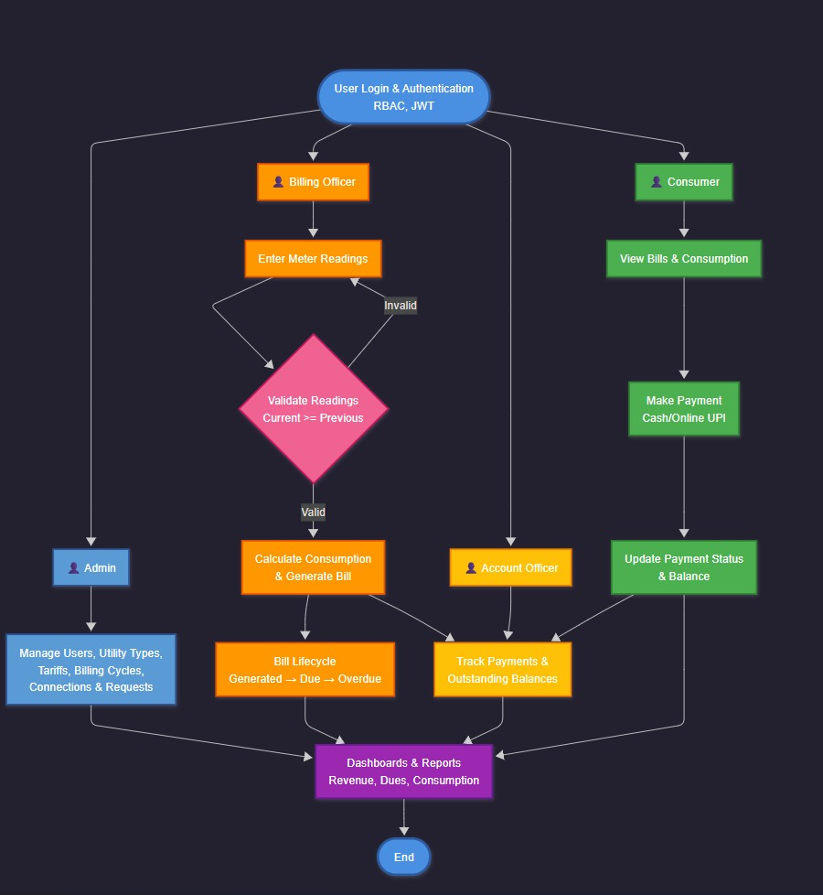
System Flowchart
The flowchart shows the end-to-end process from user authentication to reporting. After login with role-based access control (RBAC) and JWT, four user roles access the system: Admin manages configuration and connections; Billing Officer enters meter readings and generates bills; Account Officer tracks payments and outstanding balances; and Consumer views bills and makes payments.
The flow includes validation checks, bill lifecycle management (Generated → Due → Overdue), and payment processing, converging into dashboards and reports for revenue, outstanding dues, and consumption analytics.

Slide 10
Security Features
Core Security Pillars
JWT Authentication: Implements token-based authentication for secure communication between the Angular frontend and ASP.NET Core API.
Role-Based Access Control (RBAC): Restricts system functionality (Admin, Billing, Account, Consumer) based on verified user identities and assigned permissions.
Secure API Design: Protected endpoints for billing and payments to prevent unauthorized data access or manipulation.
Technical Safeguards
Data Protection: Utilizes DTOs (Data Transfer Objects) in the backend to prevent the exposure of sensitive database entities to the client.
Identity Guards: Angular-based route guards and HTTP interceptors ensure that only authenticated users with valid tokens can access specific feature modules.
Robust Error Handling: A global exception handling middleware masks detailed server-side errors from end users while logging issues for administrators.

Slide 11
Quality Assurance and Testing
Unit testing using xUnit framework validates individual service components, business logic, and data calculations including bill generation, payment processing, and LINQ-based report aggregations.
Integration testing through Postman verifies all REST API endpoints, covering successful operations, error handling, validation scenarios, and edge cases.
Extensive authentication and authorization test cases ensure JWT token generation and validation, role-based access control enforcement across Admin, Billing Officer, Account Officer, and Consumer roles, and secure data isolation.
Tools Used
xUnit – unit & integration tests (.NET)
Postman – API testing
Swagger – API documentation & quick verification

Slide 12
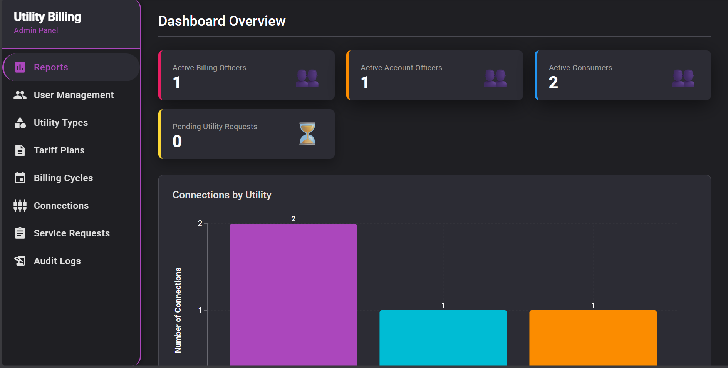
Admin Dashboard

Slide 13
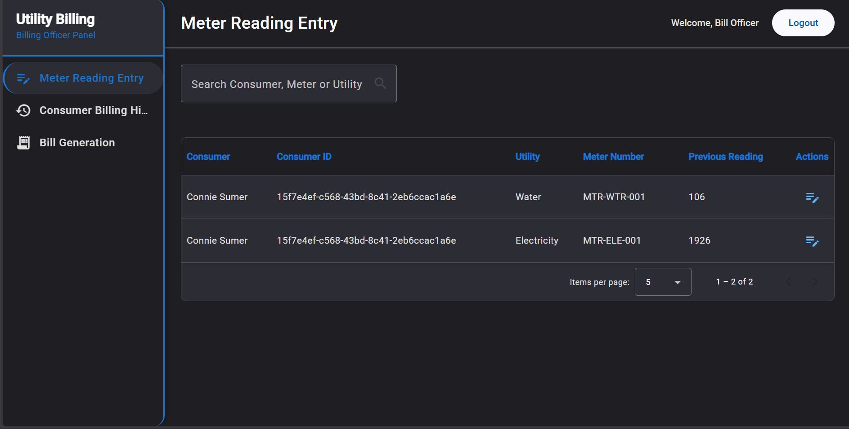
Billing Officer – Meter Reading Screen

Slide 14
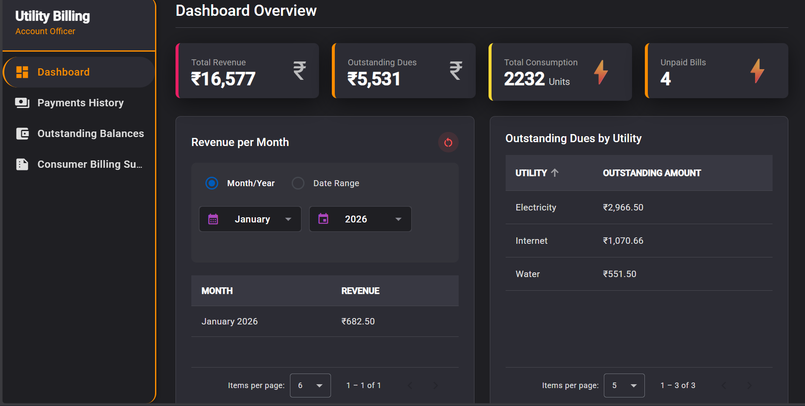
Account Officer Dashboard

Slide 15
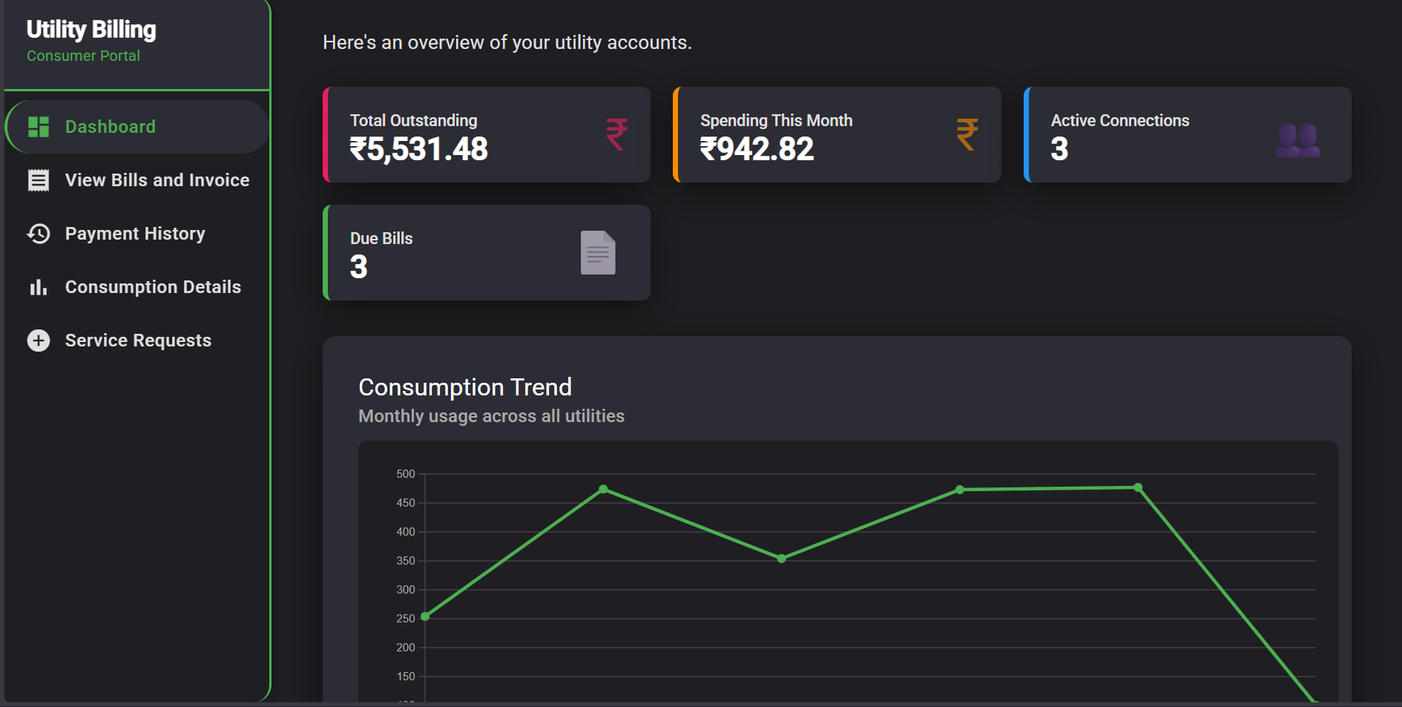
Consumer Dashboard

Slide 16
Live Demonstration

